Slide 1
JS5: Lesson #9

Slide 2
Agenda
Arrays and Hash Tables
Array vs. Hash Table
Objects in JS
Object vs. HashTable
Constructors
Inheritance in JS
Built-in Objects
Extending built-in types

Slide 3
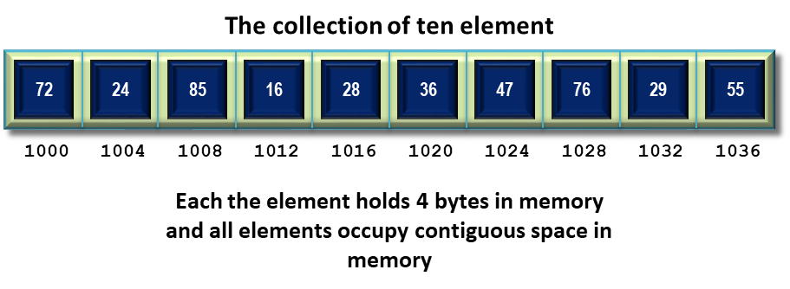
Concept of the Array
The Array is a data type that is meant to describe a collection of elements (values or variables) with multilinear element addressing.

Slide 4
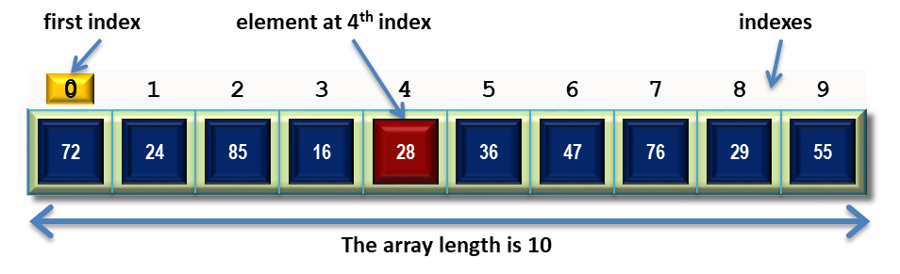
Concept of the Array
Each element can be selected by index (identifying key).
All indexes restricted to integer values and all elements are ordered according to their indexes.

Slide 5
JavaScript Arrays features
Array in JavaScript differs of array in classical languages.
Array in JS it's a species of Object.
So Array in JS can be ease resizable, can be cross-typical and can have string as an index.
And more:
if we create empty array it is real empty.
if we insert element with index 5 into this empty array we get array with only one element. A[5]=11;

Slide 6
Creation of Arrays
Exist two base ways for creation of array:
var name = []; // correct way
or
var name = new Array()
First way (with using indexer []) is modern and strong recommended for use.
Second way (with new and Array constructor) is deprecated now and not recommended.

Slide 7
Processing of Arrays
Ways of array using:
declaration of empty array
declaration of filled array
writing of value in element with index 0
reading of value by index (tmp = 16)
getting length of array (in example 3)
var array = [];
var array = [5, 8, 16];
array[0] = 4;
var tmp = array[2];
var size = array.length;

Slide 8
Processing of Arrays
How we can read and print in console all elements of array? The for statement help us:
var array = [4, 8, 16, 32];
for (var i = 0; i < array.length; i++) { console.log(array[i]); }
Note: it’s work only for digits in indexes. Do not use in array with not-digital indexes.

Slide 9
Processing of Arrays
Not so long ago array received very comfortable method forEach.
This method travel by array elements and call you callback function for each of them.
var array = [4, 8, 16, 32]; array.forEach(function (element, index) { console.log(index + ' => ' + element); });
It's way prevent errors refers on spaces in your Array.

Slide 10
Useful methods
Some suitable functions from Array:
push(value) – insert element in end of array.
pop() – extract element from end of array.
unshift(value) – insert element before first
shift() – extract first element.
join() – concatenate all elements of array in string.
split() – divide string on elements of array.
sort() – built-in method of array sorting.

Slide 11
Creation of Hash Tables
Sometimes we need an Array with string indexes (keys).
There is a special data structure for such case: hash table.
var name = {};
Hash table is an usual JavaScript object without methods.
To access elements use array syntax with string index instead of numerical index.

Slide 12
Creation of Hash Tables
We can create hash and initialize it at the same time.
For this we should write values separated by a comma like in array.
But for all values we have to set string key:
var name = {
key: value,
key: value
};
Note: this format of describing of JS object has its own name: JavaScript Object Notation or short JSON.

Slide 13
Usage of Hash Table:
Usage of hash-tables is very similar to arrays:
var marks = { excellent: 5, good: null, satisfactorily: 3, bad: 2 }; marks['good'] = 4; var mark = marks['good']; console.log(mark);

Slide 14
Usage of Hash Table:
The difference is in usage of for-in statement:
Example:
for (var key in hash) {
console.log(hash[key]);
}
for (var mark in marks) { console.log(mark + ' => ' + marks[mark]); }

Slide 15
Array vs. Hash Table
Use Array for collections with digital indexes.
Use Hash if you want use string keys.
Don't look for property length in Hash.
Don't look for forEach and other Array methods in Hash.
Don't use for with Hash, use for-in instead.

Slide 16
Practice Tasks
Create an array of 10 numbers.
Write function which will be takes array and returns:
the biggest of these numbers in the array;
the smallest of these numbers in the array;
the sum of positive numbers in the array;
the product of negative numbers in the array;
the amount of negative and positive numbers in the array.

Slide 17
Object creation
JavaScript Objects are containers for named values called properties.
A Property is a “key: value” pair, where a key is a string (also called a “property name”), and value can be anything.
An object may also have a function as a member, in which case it will be known as a Method of that object.
A simple object can be created with figure brackets {} with an optional list of properties.
var obj = { /* properties */ };

Slide 18
Object creation
Let us look at an example of a JavaScript Object:
var cat = { name: 'Murzik', color: 'white', run: function () { return "Murzik run!"; } }; console.log(cat.name); console.log(cat.color); console.log(cat.run());

Slide 19
Object creation
You know that we can create a simple object in JavaScript use JSON notation for this:
var cat = { name: 'Murzik', color: 'white' };

Slide 20

Object or Hash Table
But this way it looks like hash table creation.
What is the difference between hash table and object, then?
var hash = {
key: value,
key: value
};
var object = {
key: value,
key: value
};

Slide 21
Object or Hash Table
Typically we use hash table if we want to represent some collection, and we use an object to describe some system or entity.
var cats = { first: 'Murzik', second: 'Barsik' };
some collection
var cat = { name: 'Murzik', color: white' };
some entity

Slide 22
Difference in use
There are some differences in using of hash tables and objects as a result. For example:
cats["first"]; // good way
To access elements of hash table we use indexer [] with key inside.
But it's incorrect for objects! For objects operator "." should be used :
cat["name"]; // incorrect! cat.name; // good way

Slide 23
Properties of object [Rules]
Each object should have properties that representing state of object.
If name of property is a reserved word it must be in quotes.
If name of property consist of spaces or hyphens it must be in quotes.
var book = { "main title": "JavaScript", "sub-title": "The Definitive Guide", "for": "students", author: { name: "David", surname: "Flanagan" } };

Slide 24
Read / Write object properties
var book = { "main title": "JavaScript", "sub-title": "The Definitive Guide", "for": "students", author: { name: "David", surname: "Flanagan" } }; console.log(book["main title"]); console.log(book["sub-title"]); console.log(book["for"]); console.log(book.author.name); console.log(book.author.surname);

Slide 25
Constructors
Sometimes we need to create more than one single object.
It is not a good idea to use the literal way for this.
It will be better create a scenario for objects reproducing.
The Constructor is a function that implements this scenario in JavaScript.
Constructor consists of declaration attributes and methods that should be added into each new object with presented structure.

Slide 26
Constructors: example
Example:
function Cat(name, color) { this.name = name; this.color = color; this.run = function () { console.log(this.color + " " + this.name + " run!"); }; } var murzyk = new Cat("Murzik", "White"); murzyk.run();

Slide 27
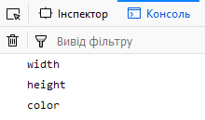
Inheritance in JS
var Shape = { color: "red", }; function Rectangle(w, h) { this.width = w; this.height = h; } Rectangle.prototype = Shape; // inheritance var rectangle = new Rectangle(15, 8); for (var key in rectangle) { //if(shape.hasOwnProperty(key)) console.log(key); }

Slide 28

Inheritance in JS
Rectangle.prototype.toString = function() { return "Color: " + this.color + ", Width: " + this.width + ", Height: " + this.height; }; var rectangle = new Rectangle(15, 8); console.log("" + rectangle);

Slide 29
JavaScript Built-in Objects
Object – base super object
Number – represents integer and real numbers
String – represents sequence of characters
Boolean – represents logical values (true or false)
Date – working with date and time
Array – represents array
Math – mathematical methods
RegExp – regular expressions

Slide 30

Extending built-in types
Little example from https://w3schools.com
Array.prototype.upperCase = function() { var len = this.length; for (var i=0; i<len; i++) { this[i] = this[i].toUpperCase(); } }; var arr = ["apple", "rasberry", "strawberry", "orange"]; console.log(arr); arr.upperCase(); console.log(arr);

Slide 31
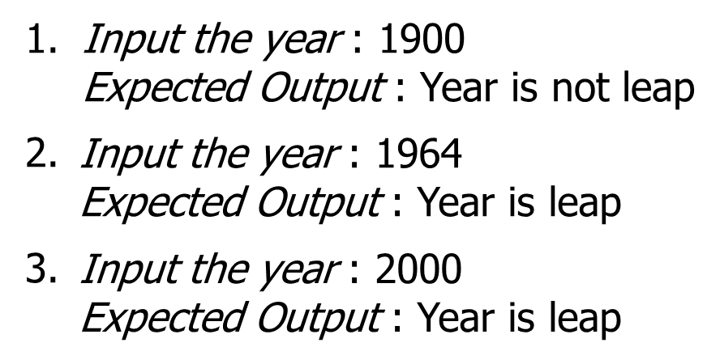
HomeWork
Write function with name isLeap(year) to check if year is leap.
The function isLeap(year) must return true if year is leap and false otherwise.
Every year that is exactly divisible by 4 is a leap year, except for years that are exactly divisible by 100, but these centurial years are leap years if they are exactly divisible by 400.

Slide 32
Contacts
Europe Headquarters
52 V. Velykoho Str.
Lviv 79053, Ukraine
Tel: +380-32-240-9090 Fax: +380-32-240-9080
E-mail: info@softserveinc.com
Website: www.softserveinc.com
US Headquarters
12800 University Drive, Suite 250 Fort Myers, FL 33907, USA
Tel: 239-690-3111 Fax: 239-690-3116
Thank You!
Copyright © 2010 SoftServe, Inc.

